Slide 1

ADVANCED LOAD BALANCING TECHNIQUES
Submitted By :
Supervised By:
Dr. Ram Shringar Raw
(Associate Professor , CSE)
NITESH MISHRA 2020UCB6044
MAMTA 2020UCB6052
End Term Review
CBCPC23 B. Tech Project – II

Slide 2
CONTENTS
Introduction
Literature Survey
Gaps Identified
Objectives of the Project
Problem Statement
Solution Methodology
Results
Future work to be done
Conclusion
References

Slide 3
INTRODUCTION
Cloud computing has emerged as a transformative paradigm, revolutionizing the way organizations utilize and manage their computing resources.
It offers a scalable and flexible model for delivering computing services over the internet, allowing users to access resources on-demand without the need for extensive upfront investment in infrastructure.
As the demand for cloud services continues to grow, efficient management of resources becomes increasingly crucial.
Load balancing plays a pivotal role in optimizing the performance and scalability of cloud computing environments. It involves the distribution of incoming network traffic or computational tasks across multiple servers or resources to ensure optimal resource utilization and improved system responsiveness.
In our project, we aim to pioneer an adaptive load balancing algorithm using the Genetic Algorithm, dynamically allocating resources in response to changing workload patterns in Cloud environments. We focus on optimizing job scheduling, enhancing system performance, and reducing operational costs by evaluating the adaptability of our approach to dynamic workload fluctuations.

Slide 4
LITERATURE SURVEY
1 Dynamic Task Scheduling:
At the ICIT 2018 conference, a study explored dynamic task scheduling in heterogeneous systems using Directed Acyclic Graphs (DAGs). The study introduced the Clustering Based HEFT with Duplication (CBHD) algorithm, which combines Triplet Clustering and HEFT to enhance load balancing and computation overhead management in Heterogeneous Computing Systems (HC).
2 Dual process approach:
An article published in IEEE Access (2021) presented a novel Load Balancing (LB) algorithm integrating Task Scheduling and Load Balancing processes for optimal cloud resource utilization. This dual-process framework dynamically adapts to varying workloads, ensuring efficient load balancing and CPU usage optimization, addressing the challenges in cloud load balancing.

Slide 5
LITERATURE SURVEY
3 Hybrid Approach:
In a recent paper, researchers introduced a hybrid differential evolution algorithm (HDEA) to solve the Travelling Salesman Problem (TSP) efficiently. By combining differential evolution with local search techniques, their approach enhances convergence speed and solution quality, offering a promising solution to combinatorial optimization problems like TSP.
4 Genetic Algorithm:
A comprehensive review discussed genetic algorithms (GAs) and their applications across various domains, highlighting their effectiveness in optimization. The review explored GA variants and practical applications, offering valuable insights and future research directions for optimizing complex optimization problems in diverse fields.

Slide 6
GAPS IDENTIFIED
Dynamic Workload Fluctuations: Traditional load balancing approaches often struggle to adapt to rapid changes in workload patterns, resulting in inefficient resource allocation. This inability to dynamically adjust to fluctuating demands leads to underutilization of resources during periods of low activity and overloading of nodes during peak times, ultimately impacting overall system efficiency.
Operational Inefficiencies: Suboptimal load balancing exacerbates operational inefficiencies by causing increased response times and higher operational costs. Underutilized resources remain idle, while overloaded nodes experience performance degradation, leading to decreased user satisfaction and potential revenue loss for service providers.

Slide 7
GAPS IDENTIFIED
Limitations of Current Approaches: Traditional load balancing methods lack the adaptability required to address the evolving complexities of modern Cloud infrastructures. These approaches often rely on static strategies that do not effectively optimize resource allocation in dynamic environments, hindering the scalability and performance of cloud systems.
Growing Scale and Complexity: As Cloud environments continue to scale in size and complexity, the challenges associated with load balancing become more pronounced. The sheer volume of data and diverse workloads present in modern Cloud infrastructures necessitates more sophisticated and adaptive load balancing solutions to ensure optimal resource utilization and system performance.

Slide 8
OBJECTIVE OF THE PROJECT
Comparison with Traditional Methods:
Conduct a comparative analysis between the proposed Genetic Algorithm-based approach and traditional load balancing methods, evaluating performance metrics, responsiveness, and scalability.
Develop an Adaptive Load Balancing Algorithm:
Design and implement an adaptive load balancing algorithm, leveraging the Genetic Algorithm, to dynamically allocate resources based on changing workload patterns in Cloud computing.
Enhance System Performance:
Improve overall system performance by fine-tuning load distribution mechanisms, reducing bottlenecks, and maximizing resource utilization through the proposed advanced load balancing approach.
Mitigate Operational Costs:
Evaluate the impact of the developed algorithm on operational costs, aiming to minimize unnecessary expenditures associated with underutilized resources and inefficient load distribution.

Slide 9
PROBLEM STATEMENT
Existing load balancing methods in Cloud computing lack adaptability and may not effectively respond to dynamic workload changes, leading to suboptimal resource allocation and system performance. A comparative analysis is needed to evaluate the performance, responsiveness, and scalability of the proposed Genetic Algorithm-based approach against traditional load balancing methods. This analysis will provide insights into the effectiveness of the proposed approach in dynamically allocating resources and optimizing system performance under varying workload conditions.
Current load balancing algorithms in Cloud computing often struggle to dynamically adapt to changing workload patterns, resulting in inefficient resource allocation and operational inefficiencies. There is a need to develop an adaptive load balancing algorithm leveraging the Genetic Algorithm to address these challenges. This algorithm should dynamically allocate resources based on changing workload patterns, optimizing job scheduling, enhancing overall system performance, and mitigating operational costs associated with inefficient resource utilization.

Slide 10
SOLUTION METHODOLOGY
Developing an advanced load balancing algorithm using Swarm Intelligence involves leveraging principles from collective behavior observed in natural systems. This approach integrates key steps, starting from initialization, where parameters are set and populations are initialized, to simulation, where the algorithm's performance is evaluated.
The components of the algorithm include fitness evaluation, where the quality of potential solutions is assessed, followed by selection mechanisms such as tournament selection to choose the fittest individuals. Crossover and mutation operations are then applied to create new solutions, mimicking genetic processes in natural systems.
To validate the effectiveness of the developed algorithm, simulations are conducted using CloudSim, a widely-used tool for modelling and experimenting with cloud computing services. CloudSim enables the creation of realistic cloud environments, allowing researchers to assess the algorithm's performance under various scenarios and workload conditions.
The research focuses on heuristic job scheduling algorithms, particularly prioritizing Online Mode scheduling algorithms like Ant Colony Optimization and Honeybee Optimization. These algorithms are chosen for their adaptability to dynamic processor speeds in cloud environments, making them suitable candidates for addressing load balancing challenges effectively.

Slide 11
SOLUTION METHODOLOGY
Algorithm 1: Ant Colony Optimization (ACO)
Principle: Inspired by foraging behavior of ants, ACO deposits pheromone trails on paths, influencing path selection based on pheromone levels.
Pseudocode:
Initialize pheromone levels on all paths.
Ants choose paths based on pheromone levels and heuristic information.
Update pheromone levels based on ant trails.
Evaporate pheromone levels to prevent stagnation.
Repeat until termination condition is met.
Algorithm 2: Honeybee Optimization
Principle: Mimics foraging behavior of honeybees, optimizing exploration and exploitation of potential solutions.
Pseudocode:
Initialize scout bees and employed bees with random solutions.
Employed bees exploit food sources and communicate findings through waggle dance.
Onlooker bees choose food sources based on employed bees' information.
Update employed bees and scout bees perform random searches.
Repeat until termination condition is met.

Slide 12
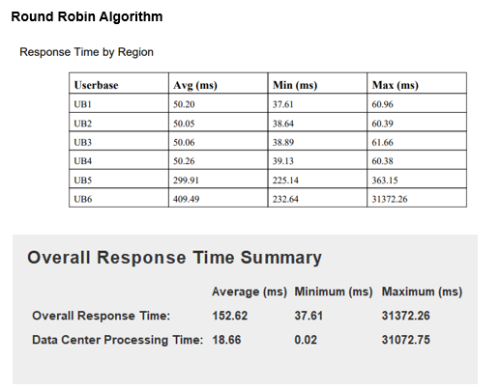
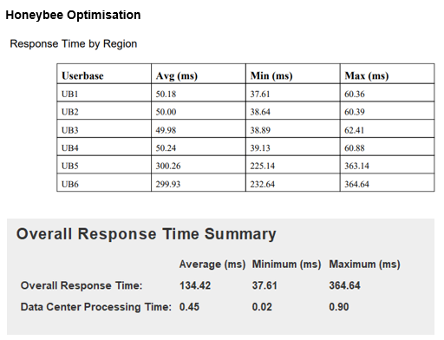
RESULTS

Slide 13
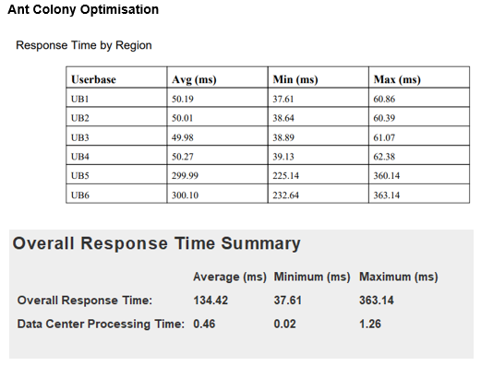
RESULTS

Slide 14
FUTURE WORK TO BE DONE
Exploration of Hybrid Load Balancing Approaches:
One key area of future work involves exploring hybrid load balancing approaches that combine Swarm Intelligence techniques (such as ACO and Honeybee) with machine learning algos. By leveraging strengths in different methodologies, hybrid approaches can enhance adaptability, scalability, and performance optimization in dynamic cloud environments. Research efforts could focus on developing novel hybrid algorithms that intelligently adapt to varying workload patterns, leveraging historical data and real-time feedback to optimize resource allocation.
Real-World Deployment and Validation:
Validating optimized load balancing strategies in real-world cloud environments is essential to assess scalability, reliability, and cost-effectiveness in diverse operational settings. Future research should prioritize real-world deployment of advanced load balancing algorithms, collaborating with industry partners to implement and evaluate these strategies in production cloud infrastructures. Through rigorous testing and validation, researchers can gain insights into the practical implications and performance characteristics of optimized load balancing techniques, facilitating wider adoption and implementation across cloud service providers.

Slide 15
FUTURE WORK TO BE DONE
Integration of Security Mechanisms
Integrating security mechanisms into load balancing algorithms represents a critical area of future research. Cloud computing environments are inherently vulnerable to security threats, and load balancing strategies must incorporate robust security measures to protect sensitive data and mitigate potential risks. Future studies should explore the integration of encryption techniques, access controls, and anomaly detection algorithms within load balancing frameworks to enhance data protection and ensure the integrity and confidentiality of cloud-based services.

Slide 16
CONCLUSION
Algorithm Performance:
Through comprehensive comparative analysis, it was found that various load balancing algorithms exhibited effectiveness in managing cloud resources. Notably, the Genetic Algorithm (GA) stood out as the most efficient strategy, particularly in dynamically changing workload scenarios. This highlights the importance of selecting the appropriate algorithm for optimizing resource allocation in cloud environments.
Highlighting Effective Techniques:
The study showcased the efficacy of Swarm Intelligence-based approaches, such as Honeybee Optimization and Ant Colony Optimization (ACO), in addition to traditional Round Robin scheduling. By demonstrating their ability to optimize cloud resource utilization, the research emphasized the relevance of these advanced techniques in modern cloud computing practices.

Slide 17
CONCLUSION
Informing Decision-Making:
The research played a pivotal role in providing decision-makers with actionable data on the performance of various load balancing algorithms. By providing decision-makers with valuable insights into the performance of different load balancing algorithms, the research empowered them to make informed decisions regarding cloud infrastructure management. This actionable data enables organizations to implement strategies that enhance efficiency, responsiveness, and overall performance in their cloud environments. Furthermore, the research not only informs decision-making at present but also lays the foundation for future advancements and optimizations in cloud infrastructure management practices, ensuring that organizations remain agile and adaptable in an ever-evolving technological landscape.

Slide 18

References
[1] "Dynamic Task Scheduling with Load Balancing using Genetic Algorithm," 2018 International Conference on Information Technology (ICIT), Bhubaneswar, India, 2018, pp. 91-95 by C. K. Rath, P. Biswal and S. S. Suar,
[2] "A Load Balancing Algorithm for the Data Centres to Optimize Cloud Computing Applications." IEEE Access, 9, 3065308 by Shafiq, D. A., Jhanjhi, N. Z., Abdullah, A., & Alzain, M. A. (2021).
[3] “A Hybrid Differential Evolution Algorithm for Solving the Travelling Salesman Problem" by S. Sivakumar, S. Lakshmi, and M. Praveen Kumar (2021)
[4] “A Review of Genetic Algorithm and its Applications" by Sanjana Mukherjee and Anish Sachdeva (2023)
[5] Cloud Analyst Software
( http://www.cloudbus.org/cloudsim/)
( http://www.cloudbus.org/cloudsim/CloudAnalyst.zip )

Slide 19
THANK YOU
NITESH MISHRA 2020UCB6044
MAMTA 2020UCB6052
End Term Review
CBCPC23 B. Tech Project – II

